Slide 1
KV6002 Week 7 – Reflective Writing
Dr Rebecca Nicholson

Slide 2

KV6002 Team Project and Professionalism – Week 1
Today I will:
1. Discuss what we mean by reflective writing
2. Make clear our expectations
3. Offer tips on best practice for reflective writing

Slide 3
Why a reflective report?
The learning outcomes for this module are about you learning teamwork skills and understanding what professionalism entails when developing a system / product as a team for a live client.
To do this it is important to reflect on your development and any skills / understanding gained in this module.
It is also a chance for you to demonstrate that even if things weren’t perfect with the system you have thought about possible ways to improve things if you had to do this again.

Slide 4
What is reflective writing?
The big distinction to make here is that it is NOT just describing what happened.
It is more than just recounting what happened as you developed your system.
Good reflective writing draws on literature, discusses what happens and offers suggestions and

Slide 5
Reflective Writing is Hard
Reflective writing requires you to work at the intersection of theory and practice (sometimes called praxis).
This means you need to consider:
What the current ‘theory’ or ‘best practice’ says about the thing you are discussing
What you did in practice
Evaluate what the differences were / what worked well / what did not work well
Offer some suggestions for a way forward / what you would do differently

Slide 6
Citing Literature
Reflective writing DOES require citing literature.
Literature here is likely to be a mixture of academic sources and practice-based sources such as professional guidelines / legal frameworks etc.

Slide 7

Deadlines
11th May 2023
Submit to Blackboard INDIVIDUALLY.

Slide 8

Assessments
The system produced and how functional and non-functional requirements were addressed. (25 Marks)
Project Management, Process and Personal Achievement. (25 Marks)
Professional Issues related to your project, its future use and how these would be mitigated (10 Marks)
Legal Issues related to your project, its future use and how these would be mitigated (10 Marks)
Social Issues related to your project, its future use and how these would be mitigated (10 Marks)
Ethical Issues related to your project, its future use and how these would be mitigated (10 Marks)
Cybersecurity issues related to your project, its future use and how these would be mitigated (10 marks)

Slide 9
This should be a carefully constructed essay…
NOTE this document is not:
A description of what happened
A blame finding exercise / witch hunt
We are great us – didn’t we do well!
A collection of unjustified views

Slide 10
Assignment 3 Expectations
You demonstrate that you have critically evaluated your project including:
The system,
Team project management,
Professional Issues,
Legal Issues,
Social Issues,
Ethical Issues,
Cybersecurity Issues
This should be about both your individual work and how successful the collaboration was.

Slide 11
Ok so what is reflection then?
Reflection is looking back through things you’ve done with an ‘evaluative and critical’ lens.
It is an ongoing process with the aim of continually reflecting on your practice to understand what could be improved and how to implement.
The aim is to improve your practice. In this case – your ability to work as a team to respond to a live client brief.

Slide 12
How does it differ from ‘normal’ essays?
 | Standard | Reflective
Subject | A research problem-oriented analysis; an often abstract and theoretical discussion of a specific topic | A less specified and often self-selected discussion of your pwn practice / experience with relation to the existing literature.
Evidence | External. Uses primary sources and data largely created by others | Uses primary sources created by others (documents, data etc.) as well as yourself (your own observations).
Voice | An impersonal and objective discussion. | Often asks for your own perspective; usually written in the first person.
Knowledge | Shows familiarity with the existing scholarship on the subject . | Combines scholarship and your original points derived from the task or experience
Introduction | Introduces concepts and outlines an argument. | Introduces concepts and indicates how they relate to own experience or learning
Conclusion | Relatively predictable. Draws the various threads of the discussion together. | May focus on the personal learning points. Often includes recommendations for future practice.

Slide 13
It is continually asking yourself …
What does existing best practice say?
What did I do?
How did I do?
What could I do better?

Slide 14
A good reflective essay will …
Demonstrate your familiarity and understanding of literature
Make connections between the literature and your practical experience
Reflect on your practice and critically analyse it
Demonstrate what you have learned from this
Make recommendations for future practice

Slide 15
Tips for good reflective Practice
Keep notes: log what you do weekly (you should be doing this now)
Plan effectively: think about what to include in the report (you can’t cover everything)
Choose wisely: include things that allow you to reflect effectively (pick an example where you improved but there is still something you can say about future improvements / changes)

Slide 16
Tips for good reflective Practice
Be constructive: Don’t just be negative, where things didn’t work well focus on WHY and offer ways of improving future practice.
Remember the journey: focus on what you have learned throughout the project.
Be emotive: we want to see what you feel about your practice (it’s fine to say where things were tough).

Slide 17
Tips for good reflective Practice
Constantly ask why: explain why for everything.
Your essay should be full of:
‘Because’
‘As a result’
‘This meant that’

Slide 18
Explaining the issues …
1. Working in my group was hard.
2. Working in my group was hard because we had not experienced working together as a team before.
3. Working in my group was hard because we had not experienced working in a group together before and as a result we did not know how each other liked to communicate.
4. Working in my group was hard because we had not experienced working in a group together before and as a result we did not know how each other liked to communicate. As a result there were some misunderstandings between group members. One example of this was …

Slide 19
Example 1
“The role of the community health team I was part of in this task was to offer the most appropriate package of care for the patient after her release from the hospital. It was important to ensure that the patient’s independence was maintained (Foster, 2014) while providing the best support in terms of safety and nutrition (NHS England, 2015). I found the home visit slightly uncomfortable as it was difficult for me to strike a balance between showing care and not being too imposing. Instead of talking so much I could have focussed more on listening and encouraging the patient to express her preferences. Next time I will try to be more receptive to the patient’s wishes and concerns.”
Uses literature to demonstrate best practice
Is honest about their experiences. Explains WHY it was uncomfortable.
Reflects on their own practice and what went wrong.
Offers something to improve.
Could have been better by saying HOW they were going to implement this.

Slide 20
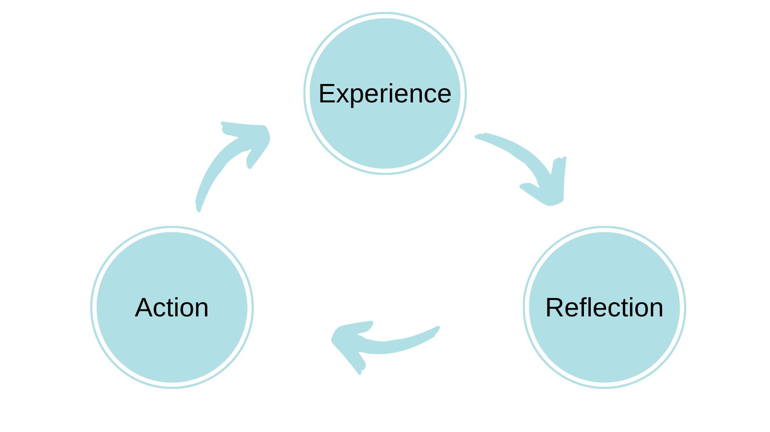
Many People have created models of reflection
The ERA Model (Jasper, 2013)
Three stages
Continuous cycle
Experience can be positive or negative
Jasper, M. (2013). Beginning Reflective Practice. Andover: Cengage Learning.

Slide 21
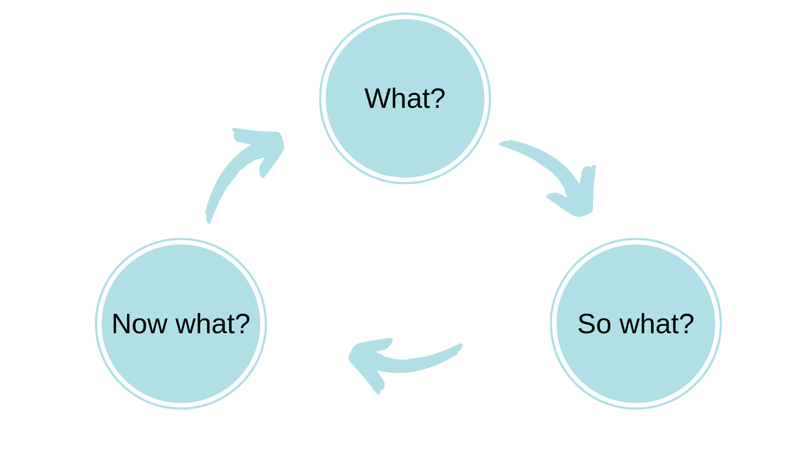
Many People have created models of reflection
So What Model (Driscoll, 2007)
Three stages
Continuous cycle
Three ‘simple’ questions
What was the situation / experience?
What will we learn as a result?
How will we use this to improve later?
Driscoll, J. (ed.) (2007) Practicing Clinical Supervision: A Reflective Approach for Healthcare Professionals. Edinburgh: Elsevier.

Slide 22
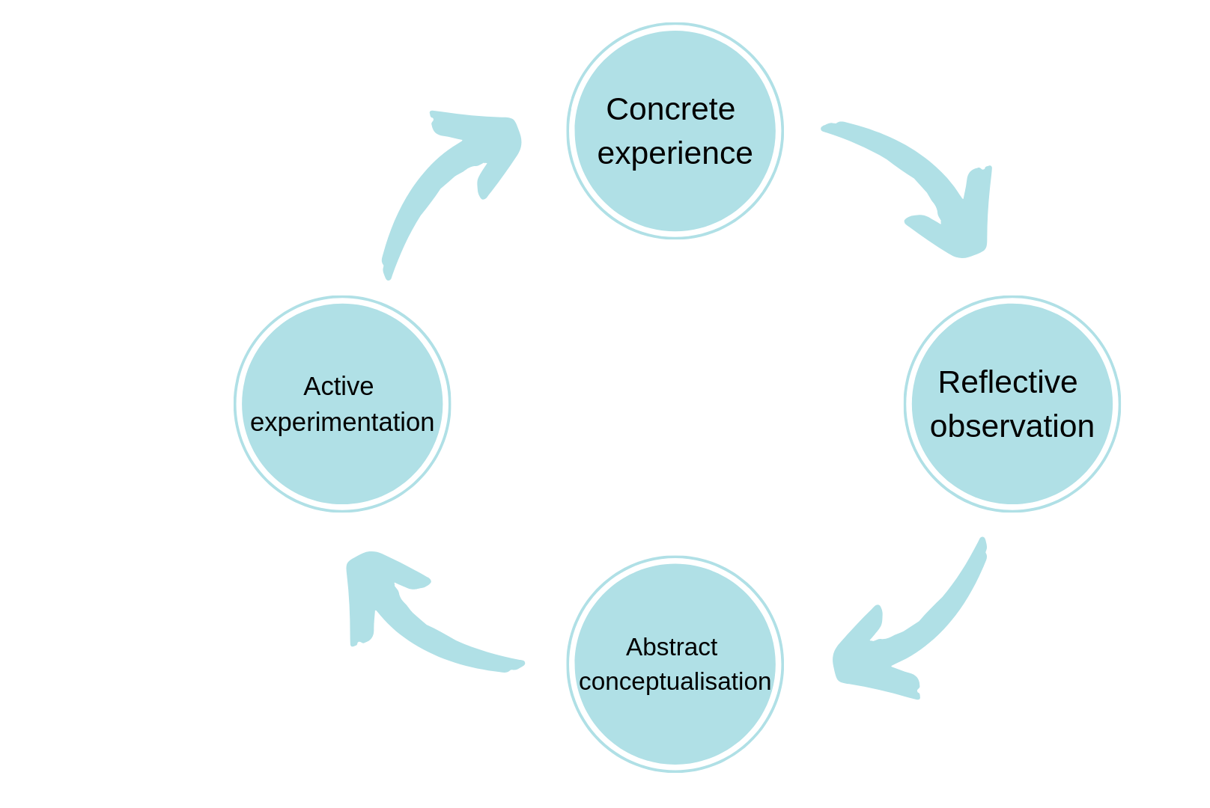
Many People have created models of reflection
Experiential Learning (Kolb, 1984)
Four stages
Continuous cycle
Stages focus on learning:
CE = actual experience – hands on doing
RO = noting anything new about this experience
AC = what new ideas do we have as a result
AE = try new ideas in new situations
Kolb, D. (1984) Experiential Learning: Experience as the Source of Learning and Development. Upper Saddle River: Prentice Hall.

Slide 23
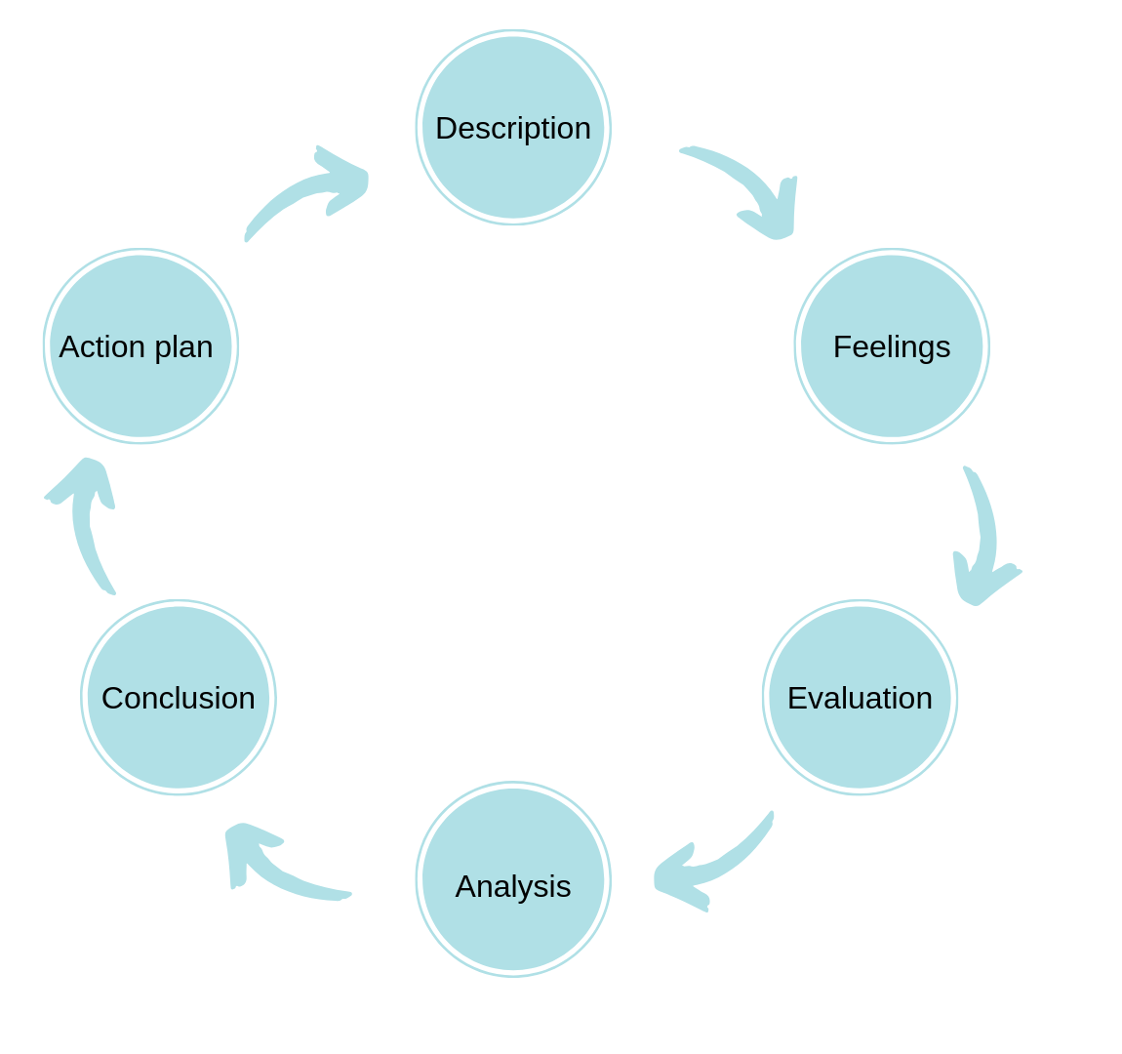
Many People have created models of reflection
Reflective Cycle (Gibb, 1998)
Six stages
Description of experience
Reflect on feelings
Evaluate that experience
Analyse to work out what you could have done differently
Reach a conclusion about what actions to change
Creating an action plan for the future
Continuous cycle
Gibbs, G. (1998) Learning by Doing: A Guide to Teaching and Learning Methods. Oxford: Further Education Unit, Oxford Polytechic.

Slide 24
Using a reflective cycle to structure your report.
This can help.
Sometimes this can feel too prescriptive though so you might not use it all the time.

Slide 25
Use Examples
Make sure whatever you do and however you structure your report you give clear examples.
Use appendices where it is helpful.

Slide 26
Example 2
We created a comprehensive testing plan (see appendix 1) that covered the six most common elements of testing (testing, 2022). When we implemented it in practice however, we found that it was not that suitable for the system we had developed because it focussed too much on individual subsystems and not enough on testing the final integration. As we had developed the plan, the team were keen to follow it through, however in hindsight we should have been more flexible and altered the plan to suit as we went along. In future, I will develop a testing plan with further options for testing that can be selected depending on the type of project and the point of the development cycle we are at.
Uses an appendix for detailed info & doesn’t take up lots of the wordcount explaining it.
Explains how it adheres to current good practice in literature.
Explains what the experience of using it was and WHY that was an issue.
Reflects on what could have been different at the time.
Offers a suggestion for the future.

Slide 27
Lecture Arrangements Weeks 8-12
Week 8 | 17th March | Assignment 2 Drop In Session [Clarification about the assignment / demo / submission] | ELB116 | RN
Week 9 | 24th March | Assignment 2 Drop In Session [Clarification about the assignment / demo / submission] | ELB116 | RN
EASTER BREAK
Week 10 | 21st April | Assignment 3 Drop In Session [Clarification about assignment / reflective writing] | As timetable | AG
Week 11 | 28th April | Assignment 3 Drop In Session [Clarification about assignment / reflective writing] | As timetable | SH

Slide 28
Easter Holiday Arrangements
28th March – 29th April
Contact supervisors in the first instance. I am contactable via email but likely to be slow to respond as I might have intermittent wifi.
Alan and Shanfeng are running the drop in sessions for the reflective report – please contact them if you want to book a time in those sessions to meet with them.

Slide 29
Assignment 1 Marks
I will release today – approx. 4.30pm
Supervisors have marked assignments. Any queries speak to them / me as appropriate.
I am in meetings all day Mon 13th March so I’m unlikely to respond until Tuesday to any queries.
I will look to priorities those on Tuesday as much as possible.

Slide 30
Week 7 expectations.
As a minimum you need to have:
Completed your planned tasks this week
Updated your log
Updated your task completion monitoring

